Slide 1

Capstone Project Hotel Booking Analysis
Team Member
SYED FARUK

Slide 2

POINTS TO DISCUSS :
Details of project with Work flow
Data collection
Data cleaning
Analysis
Questions

Slide 3
Details of project with Work Flow
The hotel booking data is collected for 2 hotels for the year 2015, 2016 and 2017.
The analysis is done on data set by following below steps.
Gathering of all data required for analysis
Data collection
All collected data need to clean by replacing null values, checking the outliers and duplicates
Data Cleaning
Analysis of Collected data through various analysis tools
EDA

Slide 4
Data Collection /Description
Understanding the whole dataset with help of column names as given below
hotel : Name of hotels is_canceled : Indicating the booking was cancelled (1) or not cancelled (0) lead_time : Number of days that elapsed between the entering date of booking arrival_date_year : Year of arrival date arrival_date_month : Month of arrival date arrival_date_week_number : week number of year of arrival arrival_date_day_of_month : Day of arrival date stays_in_week_nights : The number of weekend nights (saturday and sunday) the guest stayed in hotel stays_in_week_nights : Number of week days ( monday to friday )the guest stayed in hotel adults : Number of adults stayed in hotel children : Number of childrens stayed in hotel babies : Number of babies stayed in hotel meal : type of meal booked by customers country : country of origin
market_segments : 'TA' means travel agent and 'TO' means team operators

Slide 5
Data Collection /Description
distribution_channel : Booking distribution channel is_repeated_guest : Repeated guest (1) or not repeated guest (0) previous_cancellations : Number of booking that were cancelled by customers previous_bookings_not_canceled : Number of bookings that were not cancelled by customers reserved_room_type : Code is represented by room which is booked by customer assigned_room_type : code is type of room assigned to the booking booking_changes : Number of charges made to the booking deposit_type : Indicates on the customer made a deposit to guarantee the booking agent : ID for travel agency company : Company ID entity that made booking or responsable for booking payment days_in_waiting_list : Number of days from booking to conformation booking customer_type : booking assuming for four categories adr : Average daily rate sum of all loading transactions dividing by total number of staying nights required_car_parking_spaces : Car parking space required by customer total_of_special_requests : Total special requsts made by customer reservation_status : Reservation status, assuming in three categories reservation_status_date : Date of the last status was set

Slide 6
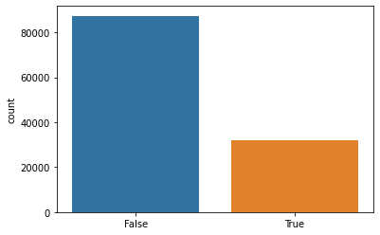
Data Cleaning
we are finding the null values from Hotel Bookings csv dataset.
Dropping the column on Hotel Bookings csv dataset because it have a more than 70 percentage of null values.
hotel_data.drop('company', axis=1, inplace=True)
hotel 0
is_canceled 0
lead_time 0
arrival_date_year 0 arrival_date_month 0 arrival_date_week_number 0 arrival_date_day_of_month 0 stays_in_weekend_nights 0 stays_in_week_nights 0
adults 0
children 0
babies 0
meal 0
country 0
market_segment 0
distribution_channel 0 is_repeated_guest 0 previous_cancellations 0 previous_bookings_not_canceled 0 reserved_room_type 0 assigned_room_type 0
booking_changes 0
deposit_type 0
agent 0
company 112593
days_in_waiting_list 0
customer_type 0
adr 0
required_car_parking_spaces 0 total_of_special_requests 0 reservation_status 0 reservation_status_date 0
Replacing the null values
hotel_data['children'].fillna('0',inplace=True) # replacing na values
hotel_data['agent'].fillna('0',inplace=True) # replacing na values
hotel_data['country'].fillna('others', inplace=True) # replacing null values
Checking for duplicate values with help of visualization.

Slide 7
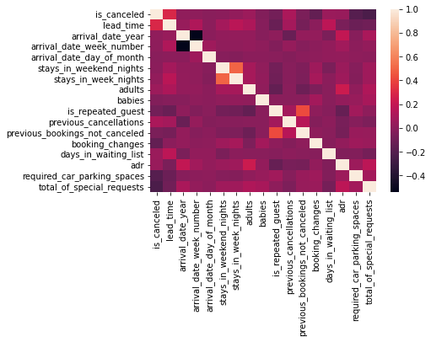
Correlation analysis
The analysis checks the correlation between columns.
Correlation visualization by heatmap -

Slide 8
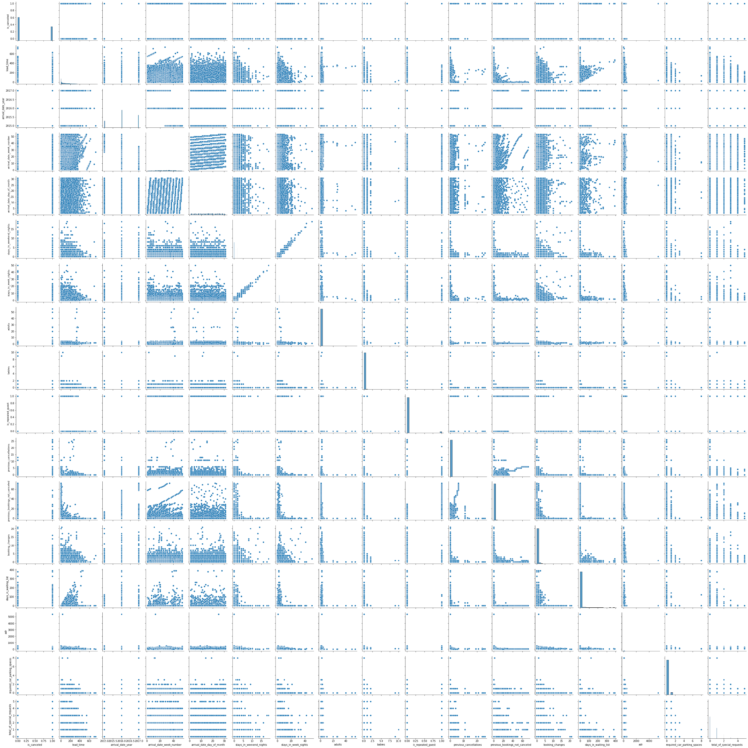
Relationship analysis between all columns with help of pair plot.

Slide 9
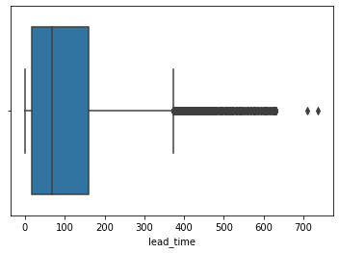
Checking outlier with help of box plot.

Slide 10
Some important questions
Some other analysis are also done which are as follows
Which hotel is most preferred by customers ?
Which month visitors visit highly ?
Which type of room highly booked and preferred by customers ?
Which year got a best sales ?
Which hotel mostly cancelled by the customers ?
Which type of customers highly visited on both hotels ?
What is the percentage of repeated guest ?
What is the percentage distribution of deposit type ?

Slide 11
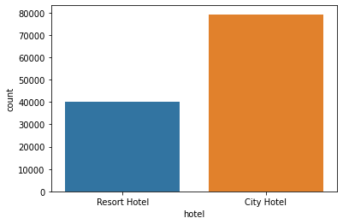
Which hotel is most prefers by customers?
There are two hotels in the dataset one is resort hotel and another is city hotel resort hotel is at 40000 mark and city hotel is at 79390 mark and total count was 119390
Answer: Guest is most preferred by city hotel because city hotel has maximum bookings.

Slide 12
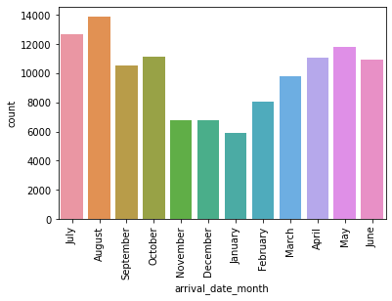
Which month visitors visit highly?
By seeing the chart for 12 months timeframe November December January period was least booking period
ANS : August month has highest number of visitors

Slide 13
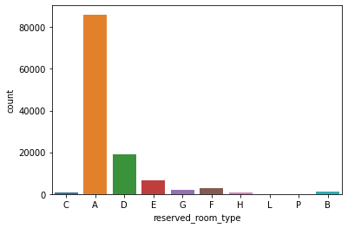
Which type of room highly booked and preferred by customers?
The city hotel has 10 rooms . The below chart is showing most preferred room by customer Like a, b, etc.
ANS : Code 'A' room are most preferred by customers because code 'A' room is highly booked by customers.

Slide 14
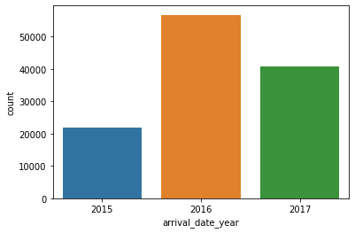
Which year got a best sales on both hotels?
Historical data representation. Using last 3 years data from 2015 to 2017. Below chart represents highest hotel bookings.
ANS : In 3 years of data we got 2016 year of sales is higher than 2015 and 2017.

Slide 15
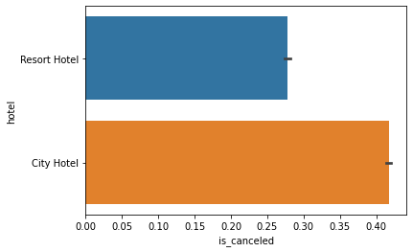
Which hotel mostly cancelled by the customers?
The below chart shows the hotel cancellation done by customers after booking confirmation
ANS: The highest cancellation is shown in city hotel

Slide 16
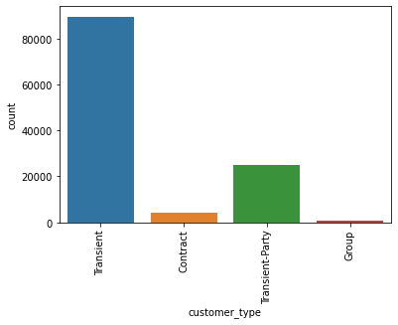
Which type of customers highly visited on both hotels?
Below chart represents different type of customers visiting hotels
ANS : Transient type of customer is highly visit on both hotels.

Slide 17
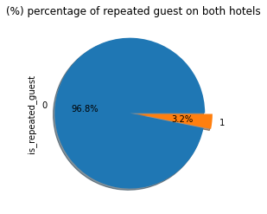
What is the percentage of repeated guest?
The below chart represents the percentage of customers visiting hotel on more than once
Ans:3.2 percentage of guest are repeated

Slide 18
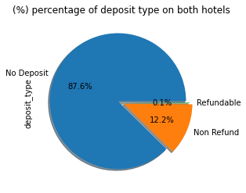
What is the percentage distribution of deposit type?
The graph is for percentage of deposit type on both hotels.
ANS : 87.6% percentage is deposit type on both hotels.

Slide 19

Challenges :
Huge amount of data was present in dataset.
Dealt with some missing values.
Huge amount of null values were present in dataset.
Faced difficulties in understanding the data.

Slide 20

The analysis played an important role in giving meaning to data and decision-making for the hotel business. Followings are findings
1. City hotel is the most preferred busiest hotel
2. 3.2% of guests are repeated guests. new guest visits are high.
3. The guest is preferred for no deposit type hotel bookings.
4. High no of bookings are done in august month.
With the use of EDA, the data can be easily understood and this can help hotel businesses in making further plans on bookings, offers, etc. to grow in the market.

Slide 21


Slide 22


